Slide 1

SmartCookie: Distributed In-Network SYN Flooding Mitigation
Sophia Yoo
Princeton University
with Xiaoqi Chen and Jen Rexford
Notes:
Hi everyone, my name is Sophia, and today I’ll be talking about SmartCookie, a distributed in-network defense to SYN flooding attacks. This work is in collaboration with Xiaoqi and Jen.
→ SLIDE TRANSITION (next slide)

Slide 2




The Attack
SYN Flooding
The most pervasive class of DDoS
Targets TCP 3WHS
SYN
SYN
memory
SYN
memory
Exhaust server memory resources
Deny legitimate client requests
Adversary
SYN-ACK
memory
SYN-ACK
SYN-ACK
Server
No return ACK
Notes:
SYN floods are the most pervasive class of DDoS attacks that target the TCP (Transmission Control Protocol) three-way handshake, which every client initiates with a server at the beginning of a potential connection
→ SLIDE TRANSITION (the attack scenario)
In the attack, the adversary floods
→ SLIDE TRANSITION (add SYN packets)
the server with many SYN packets, and the server must allocate memory
→ SLIDE TRANSITION (add memory blocks)
with state needed to later set up the connection, for each SYN packet received.
→ SLIDE TRANSITION (add SYN-ACK packets)
The server then sends SYN-ACK packets back to the adversary
→ SLIDE TRANSITION (add no ACK)
But the adversary never responds with a final ACK packet. Since the server only has a finite amount of memory
→ SLIDE TRANSITION (add warning signs)
once all the memory is consumed with these half-open connections, it can no longer accept any new connection requests.
→ SLIDE TRANSITION (next slide)

Slide 3



Traditional Defense
(with Adversary)
SYN Cookies in Server Software
Avoid consuming server memory for storing connection state
Cryptographically compute a special “cookie” value that stores relevant state
SYN
SYN
memory
SYN
Con: protect only one server at a time
Con: consume server-side compute resources
Con: stop attack traffic after it arrives at server
memory
Adversary
SYN-ACK
memory
SYN-ACK
SYN-ACK
Server
No return ACK
Notes:
A traditional defense to SYN flooding are SYN cookies,
→ SLIDE TRANSITION (add attack)
With the defense, when the server is under attack,
→ SLIDE TRANSITION (add SYN)
It avoids using memory to store connection state,
→ SLIDE TRANSITION (add cookie)
instead cryptographically generating a special cookie value that stores the relevant state to later set up the connection.
→ SLIDE TRANSITION (add SYN-ACK packet)
This cookie is placed in the SYN-ACK response packet back to the adversary
→ SLIDE TRANSITION (add ACK packet)
And even when the adversary does not complete the TCP handshake
→ SLIDE TRANSITION (add smiling memory)
the server’s memory is protected.
→ SLIDE TRANSITION (next slide)
→ SLIDE TRANSITION (downsides) There are several downsides to this traditional defense. First,it can only protect one server at a time. It also consumes server-side compute resources for generating and verifying the cookies. Finally, it only stops attack traffic after it has arrived at the server.

Slide 4

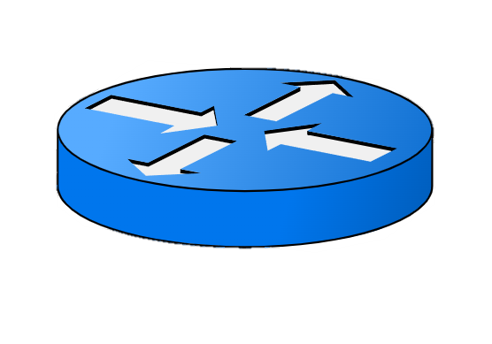
Threat Model
Improving State-of-the-Art
Clients
Pushing the Defense In-Network
Internet Core
Adversaries
Pro: high-speed, specialized in-network HW, Tbps processing
Pro: scales to protect more than one server at a time
Switches
Pushing SYN-Cookie Defense In-Network?
Service Provider Backbone
Pro: protects server memory AND compute resources
Pro: stop more attack traffic sooner
Servers
SoA: Server-Side SYN Cookies
Notes:
Traditional SYN cookie defenses have several limitations that make it infeasible to protect many servers and network resources from large-scale attacks.
→ SLIDE TRANSITION (add in-network question)
The question we would like to ask is, what if we pushed the SYN cookie defense into a programmable switch directly inside the network upstream at the network’s edge.
→ SLIDE TRANSITION (add in-network defense block)
There are many benefits to such an in network defense placement.
→ SLIDE TRANSITION (add benefits)
Programmable switches can process trillions of packets per second, and so they are uniquely positioned to defend against increasingly sophisticated DDoS attacks.
An upstream, in-network defense would scale to protect more than one server at a time.
It would protect both server memory and computational resources. It would also stop more attack traffic sooner
→ SLIDE TRANSITION (next slide)

Slide 5
Threat Model
Improving State-of-the-Art
Clients
Challenges of In-Network Defense Placement
Internet Core
Adversaries
switches have
tightly constrained programming model and limited memory
Switches
Challenges of In-Network Defense
Service Provider Backbone
keeping exact state at switch is infeasible and does not scale
Servers
Notes:
There are several important challenges that must be addressed to benefit from this in network defense placement.
→ SLIDE TRANSITION (challenges block)
Hardware switches have a tightly constrained programming model and limited amount of memory, which means it's impossible to keep exact state at the switch for handling large-scale attacks.
To address all of these challenges we present SmartCookie
→ SLIDE TRANSITION (next slide)

Slide 6


SmartCookie: Split Defense
SmartCookie: In-Network Switch + Server-Side Module
SYN
Provider Backbone
SYN
SYN
Adversary
SYN-ACK
SYN-ACK
SYN-ACK
In-Network
Edge Switch
Lightweight Server-Side Module
Server
No return ACK
Use approximate state at in-network edge switch for memory efficiency
Introduce a novel division of labor between switch + server
Achieve overall exact results and most efficient, performant defense
Notes:
Which gracefully splits the defense between an network switch and a lightweight server-side module.
→ SLIDE TRANSITION (remove smartcookie block)
The key idea is that we allow the part of our defense running in the in-network switch to keep approximate state for memory efficiency.
→ SLIDE TRANSITION
This approximate state is enabled by a novel division of labor that we introduce between the network switch and a lightweight server side module.
→ SLIDE TRANSITION
Where the server side module actually handles some defense responsibilities that would be too costly to perform in the switch.
With our split design, we’re still able to achieve our defense with exact results in the most efficient and performant manner.

Slide 7
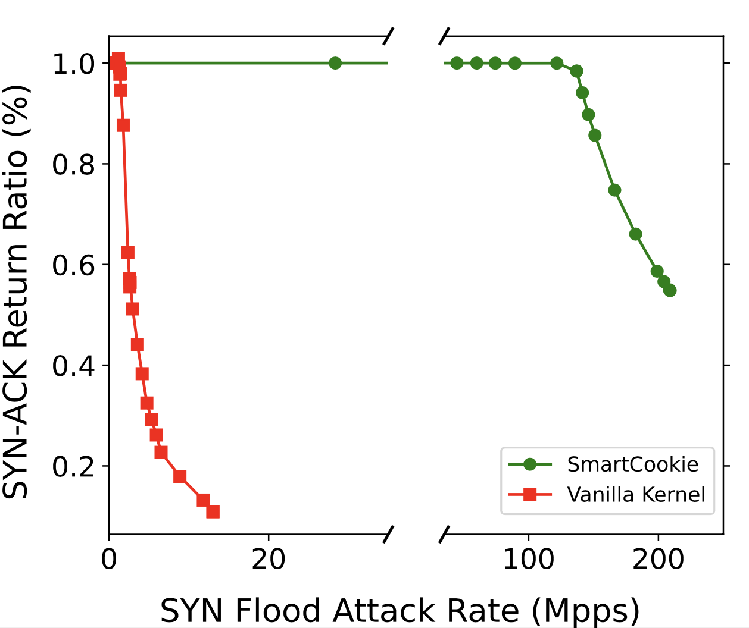
Results
Vanilla Kernel: stops 1.3 Mpps attack before pkt loss
SmartCookie: stops 136.93 Mpps attack before pkt loss
SmartCookie outperforms server defense by two orders of magnitude
Notes:
We implemented SmartCookie with P4 targeted for Tofino switches and eBPF on standard Linux servers, and showed that it is capable of defending against attack traffic rates of 136.93 million packets per second, which was two orders of magnitude greater than the attacks that were stopped by our standard Linux server defense.

Slide 8

Thank you.
Notes:
Thank you!

